Slide 1
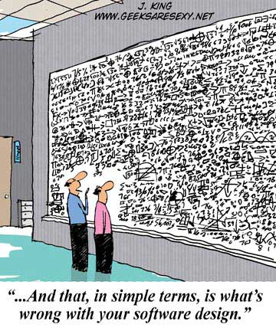

Slide 2
CS 471-1/571
Ch12 The Design Workflow

Slide 3
Overview
Object-oriented design
MSG Case Study
The design workflow
Software architecture
Formal methods for design
Tools, metrics, and challenges

Slide 4
What Is Design?
Design is the creative process of transforming the problem into a solution
The description of a solution is also known as design
  The requirements specification defines the problem
  The design document specifies a particular solution to the problem

Slide 5
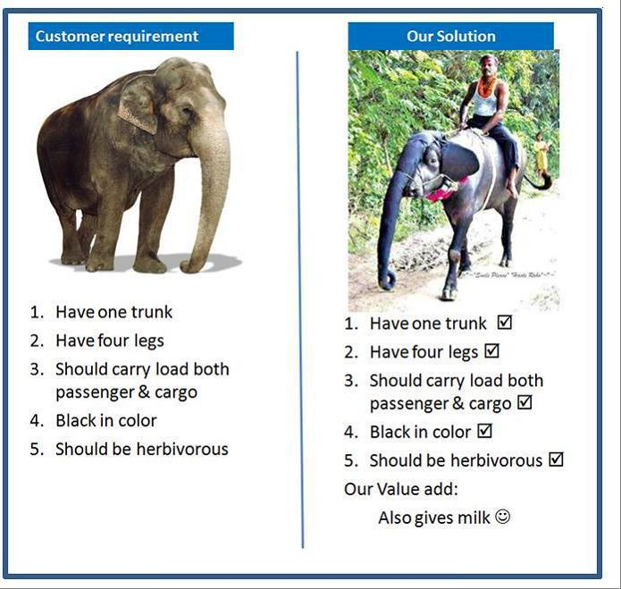

Slide 6
Software Design Is a Wicked Problem
A “wicked” problem is one that could be clearly defined only by solving it or part of it.
  Have to “solve” the problem once in order to clearly define it and then solve it again to create a solution that works.
Solutions to wicked problems are not true or false, but good or bad.
  A good solution is often only subtly different from a poor one.
Change, Change, Change!
Difficult to determine the boundary between requirements work and design work

Slide 7
Design Is a Sloppy Process
When design is “good enough”?
How much detail is enough?
  How much design should be done with a formal design notation, and how much should be left to be done at the keyboard?
When are you done?
Most common answer: when you are out of time!
  Design is open-ended.
Making mistakes is the point of design.

Slide 8
Design Techniques
Operation-oriented design
  The emphasis is on the operations
  Weakness: The data are of secondary importance
Data-oriented design
  The emphasis is on the data
  Weakness: The operations are of secondary importance
Object-oriented design
  Gives equal weight to data and operations

Slide 9
Object-Oriented Design
Design the product in terms of the classes extracted during the analysis workflow
Step 1. Complete the class diagram
  Determine the formats of the attributes
  Assign each method, either to a class or to a client that sends a message to an object of that class
Step 2. Perform the detailed design
  Data structures and algorithms

Slide 10
Complete the Class Diagram
The formats of the attributes can be directly deduced from the analysis artifacts
  Dates: U.S. mm/dd/yyyy; European dd/mm/yyyy
  The formats could be added during analysis, but never add an item to a UML diagram until strictly necessary
Assign each method to a class or to a client that sends a message to an object of that class
  If an operation is invoked by many clients of an object, assign the method to the object, not the clients
  Other approaches: responsibility-driven, information hiding

Slide 11
Perform the Detailed Design
Design each class in detail
Choose data structures
Select specific algorithms

Slide 12
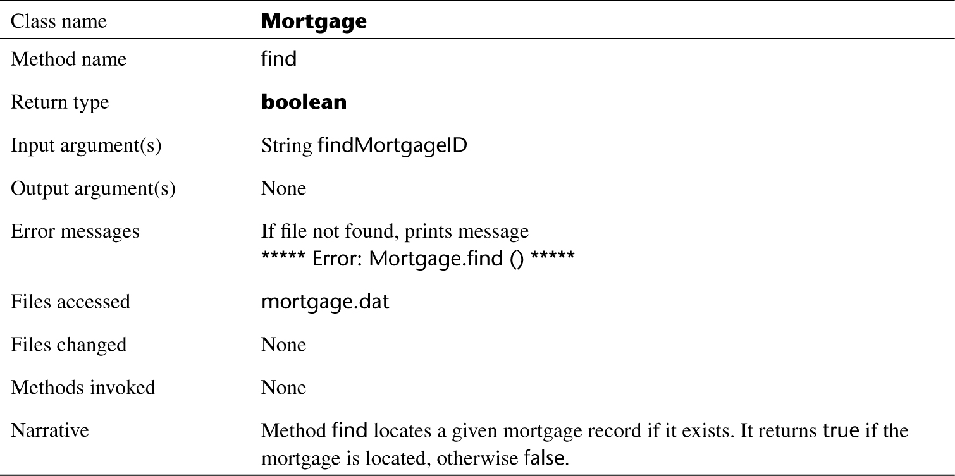
Detailed Design of Method find of Class Mortgage

Slide 13
Detailed Design in PDL
We can also write a detailed design in a program description language (PDL)
  Formerly called pseudocode
Examples: Java-like PDL description of
  Method computeEstimatedFunds of class EstimatedFundsForWeek
  Method totalWeeklyNetPayments of class Mortgage

Slide 14
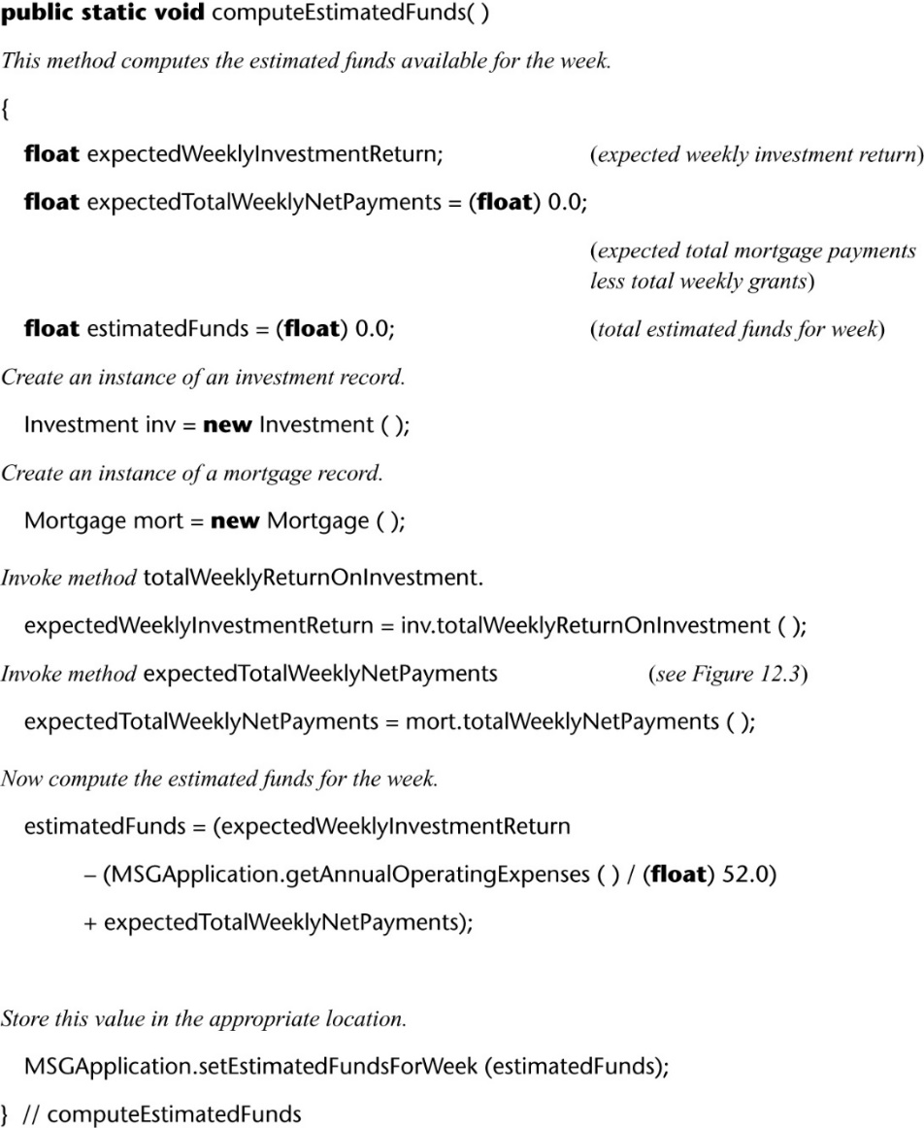
Method EstimatedFundsForWeek.computeEstimatedFunds

Slide 15
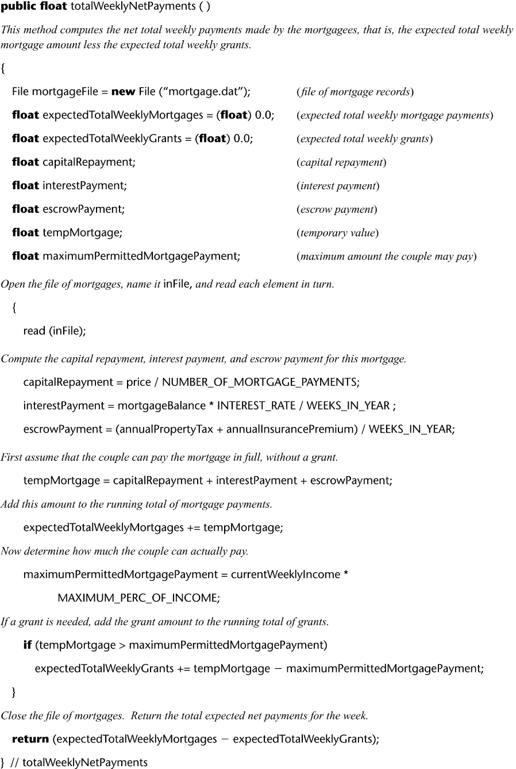
Method Mortgage.totalWeeklyNetPayments

Slide 16
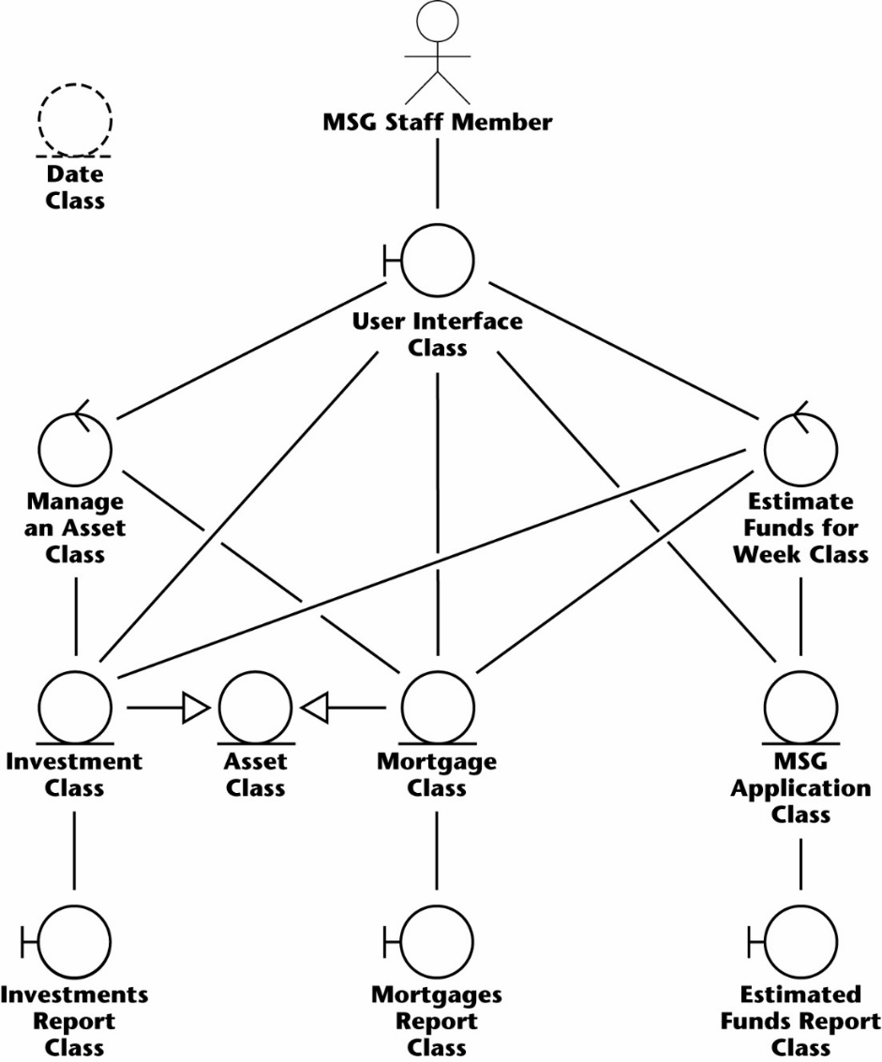
MSG: Complete the Class Diagram
Add Date class

Slide 17
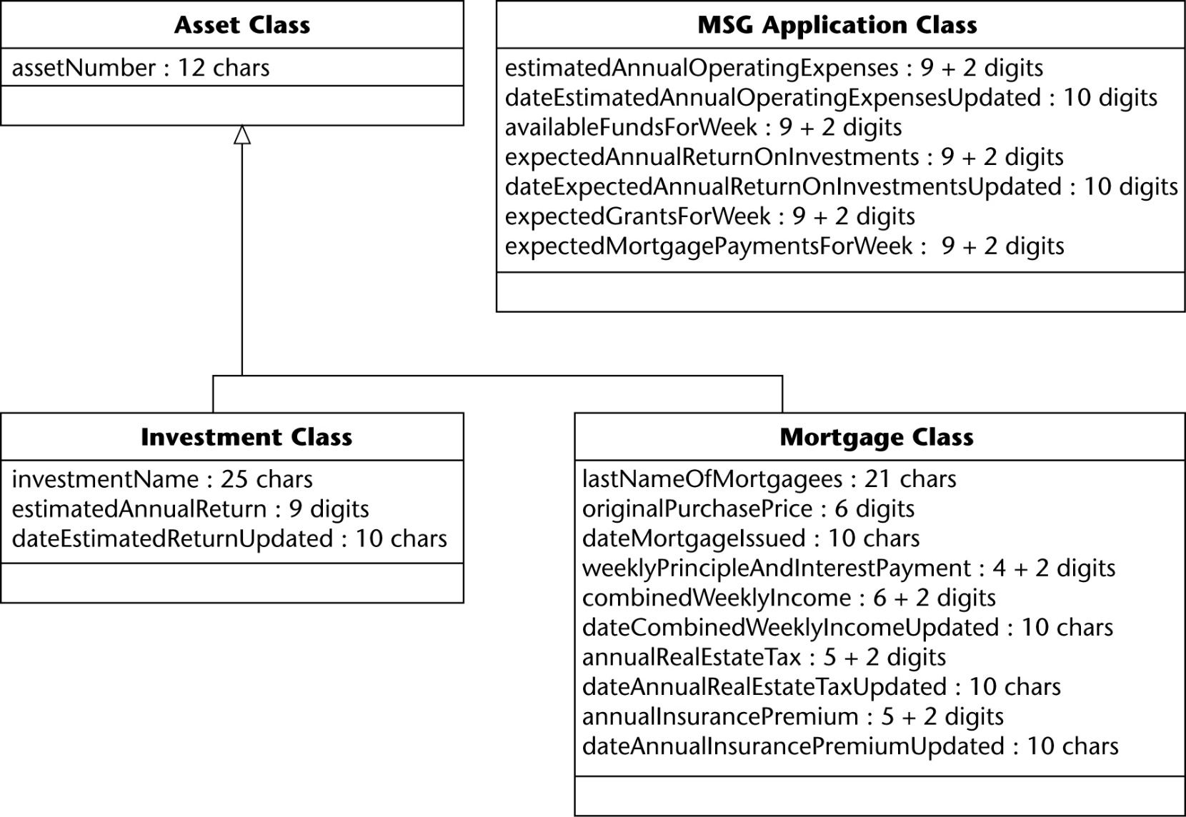
MSG: Class Diagram with Attribute Formats

Slide 18
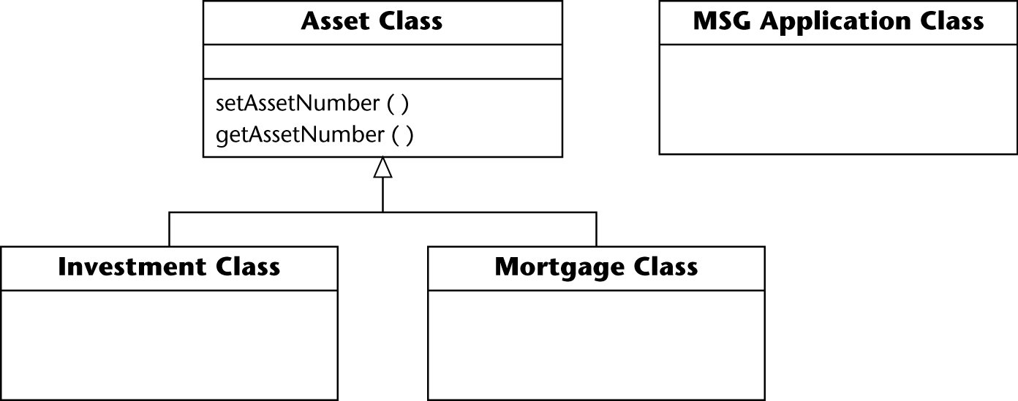
Assigning Methods to Classes: MSG
setAssetNumber, getAssetNumber
  From the inheritance tree, these accessor/mutator methods should be assigned to Asset Class
  Inherited by both subclasses of Asset Class (Investment and Mortgage Class)

Slide 19
MSG: Detailed Design
Determine what each method does
Represent the detailed design
  Tabular format for method find of class Mortgage
  PDL (pseudocode) for computeEstimatedFunds of class EstimatedFundsForWeek and for totalWeeklyNetPayments of class Mortgage

Slide 20
The Design Workflow
Iterate and increment the analysis workflow artifacts until the programmers can utilize them
Decompose a large workflow into smaller workflows (packages)
  Break up the upcoming implementation workflow into manageable pieces (subsystems)
  It does not make sense to break up the MSG case study into subsystems — it is too small
Decisions to be made:
  Implementation language, reuse, portability

Slide 21
Architectural Design
Customer requirements
"four bedrooms, three baths, lots of glass ..."
Architectural design

Slide 22
Software Architecture
An architecture: components + how they fit together
  The allocation of components to subsystems
Architecture design is performed by an architect
  Must satisfy the functional requirements (use cases)
  Must satisfy the nonfunctional requirements:
    Portability, reliability, robustness, maintainability, and security
  Must be within budget and time constraints
  The architect must assist the client by laying out the trade-offs
    Relax some requirements; increase the budget; and/or move the delivery deadline

Slide 23
Architectural Styles
Pipes and filters
Implicit invocation
Layering
Repositories
Client-server
…

Slide 24
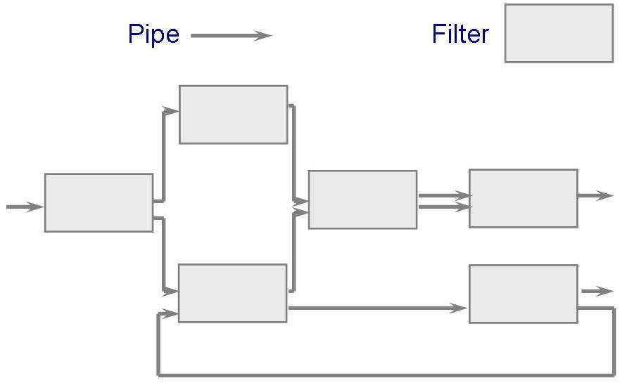
Pipes and Filters
The system has Streams of data (pipe) for input and output, and transformation of the data (filter)
Example:
  Compiler: lexical analysis, parsing, semantic analysis, code generation

Slide 25
Implicit Invocation
Event-driven, based on notation of broadcasting
  Instead of invoking a procedure directly, a component announces that one or more events have taken place
  Other components can associate a procedure with those events (registering)
  The system invokes all registered procedures
  Data exchange is through shared data in a repository
Applications
  User interfaces
  Packet-switch networks
  Databases to ensure consistency

Slide 26
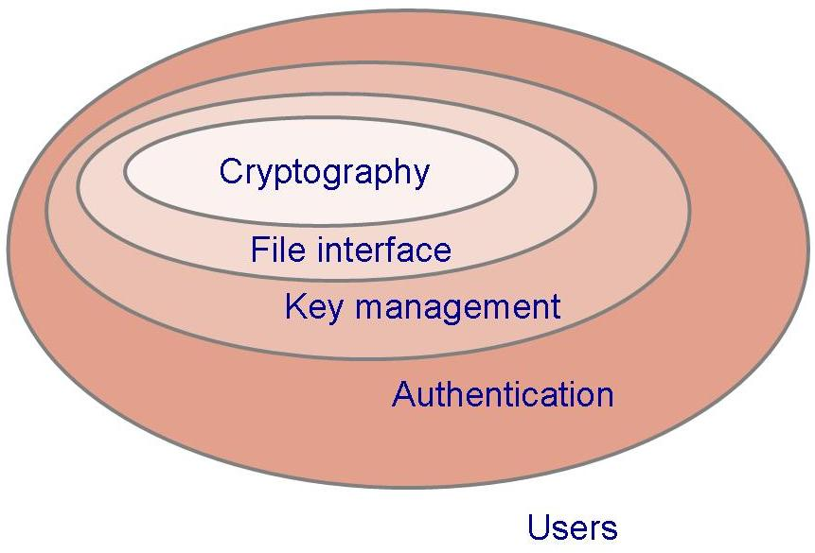
Layering
Layers are hierarchical
  Each layer provides service to the one outside it and acts as a client to the layer inside it
The design includes protocols
  Explain how each pair of layers will interact

Slide 27
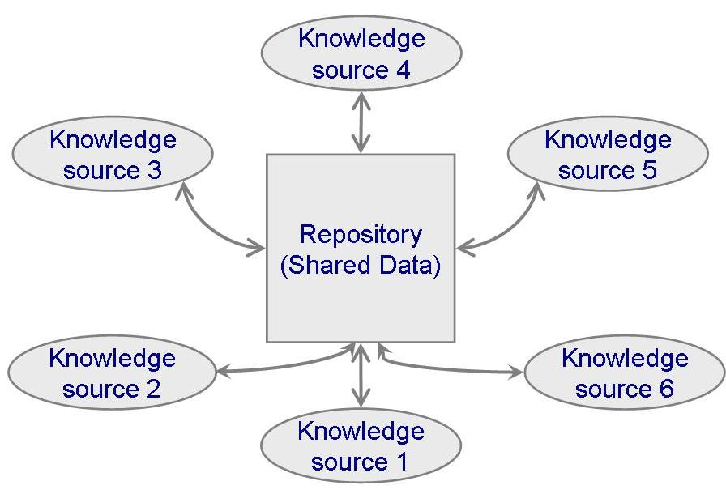
Repositories
Components: a central data store + a collection of components that operate on it
Applications
  Blackboard, search engines, libraries of reusable components

Slide 28
Other Styles
Client-server
  The server responds to the clients’ request
  The clients know the server’s identity and send messages to the server
  The server does not know in advance the number and identities of clients
Domain-specific architecture

Slide 29
The Test Workflow: Design
Design review/inspection must be performed
  The design must correctly reflect the specifications
  The design itself must be correct
Transaction-driven inspections
  Essential for transaction-oriented products
  But insufficient — specification-driven inspections are also needed

Slide 30
Formal Techniques for Design
Formal methods: mathematically-based
  State machines: FSM, EFSM, Petri nets
  Process calculi: CSP, π-calculus
  Logic and set-theory: Z, B
Use of formal design methods:
  Correctness proving can be applied to module-sized pieces
  The design should have fewer faults if it is developed in parallel with a correctness proof
  The developer will have a positive attitude to the design if she does the design and implementation

Slide 31
Formal Specification of Sorting
sort(l : Int∗) = l′ : Int∗
pre length(l) > 0
post isSorted(l′) ∧ isPermutation(l′,l)
length(l): the number of elements in a list l
isSorted(l′) = (∀ i ∈ Int : 1 ≤ i ≤ length(l′) − 1 ⇒ l′(i) ≤ l′(i+1))
isPermutation(l′,l) = (∀ e ∈ Int : count(e, l) = count(e, l′))
count(e, l): the number of times an integer e occurs in a list l (can also be formally defined)

Slide 32
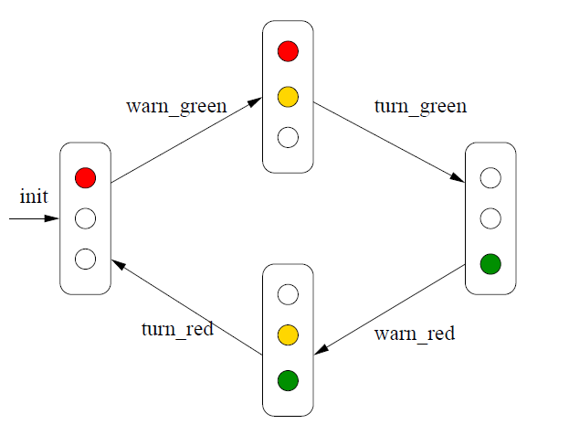
Traffic Light

Slide 33
Traffic Light Model
local
  red : Bool := true,
  yellow : Bool := false,
  green : Bool := false
begin
  [ warning green ]
  red ∧ ∼yellow ∧ ∼green → yellow′ = true
  ||
  [ turn green ]
  red ∧ yellow ∧ ∼green → red′ = false ∧ yellow′ = false ∧ green′ = true
  ||
  [ warning red ]
  ∼red ∧ ∼yellow ∧ green → yellow′ = true
  ||
  [ turn red ]
  ∼red ∧ yellow ∧ green → red′ = true ∧ yellow′ = false ∧ green′ = false
end

Slide 34
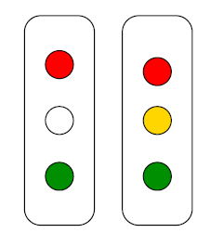
Unsafe States
TrafficLightModel ⊢ always ( ∼(red ∧ green) )

Slide 35

Petri Nets in MISTA

Slide 36
Real-Time Systems
Real-time systems
  Inputs come from the real world
    Software has no control over the timing of the inputs
  Frequently implemented on distributed software
    Communications implications
    Timing issues
Difficulties in the design
  Determining whether the timing constraints are met by the design
  Synchronization: Race conditions, Deadlock

Slide 37
CASE Tools for Design
UpperCASE tools
  Are built around a data dictionary
  Consistency checker, and screen and report generators
  Management tools for Estimating and Planning
UML Tools
  IBM Rational Rose
  ArgoUML
  Eclipse UML2 Tools

Slide 38
Metrics for Design
Measures of design quality
  Cohesion
  Coupling
  Fault statistics
Cyclomatic complexity is problematic
  Measure of internal structural complexity of code
  Data complexity is ignored
  It is not used much with the object-oriented paradigm
    Can be used for measuring method complexity

Slide 39
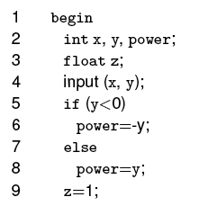
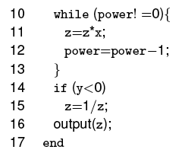
Cyclomatic Number Example: x^{y}

Slide 40
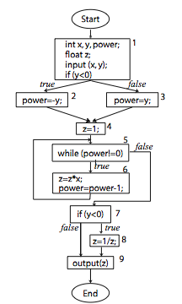
Cyclomatic Number: Control Flow Graph
N={Start, 1, 2, 3, 4, 5, 6, 7,
8, 9, End}
E={(Start,1), (1, 2), (1, 3), (2,4),
(3, 4), (4, 5), (5, 6), (6, 5), (5, 7), (7, 8), (7, 9), (8,9) (9, End)}

Slide 41
Cyclomatic Number: Equations
C = E-N+2
E (number of edges), N (number of nodes)
C = R+1,
R is the number of legitimate regions
C = D+1,
D is the number of primitive decisions

Slide 42
Challenges of the Design Workflow
The design team should not do too much
  The detailed design should not become code
The design team should not do too little
  It is essential for the design team to produce a complete detailed design
Need for great designers
  Identify potential great designers
  provide with a formal education
  Consider specific career path with appropriate rewards

Slide 43
Review of Design Principles
Find Real-World Objects
Form Consistent Abstractions (ADT)
Encapsulate Implementation Details
Inherit When Possible and Reasonable
  Q: "What’s the object-oriented way to become wealthy?"
  A: Inheritance
Information Hiding
Identify Areas Likely to Change
Aim for High Cohesion
Keep Coupling Loose
Look for Common Design Patterns

Slide 44
